Slide 1
Diffusion Code in OpenFoam

Slide 2
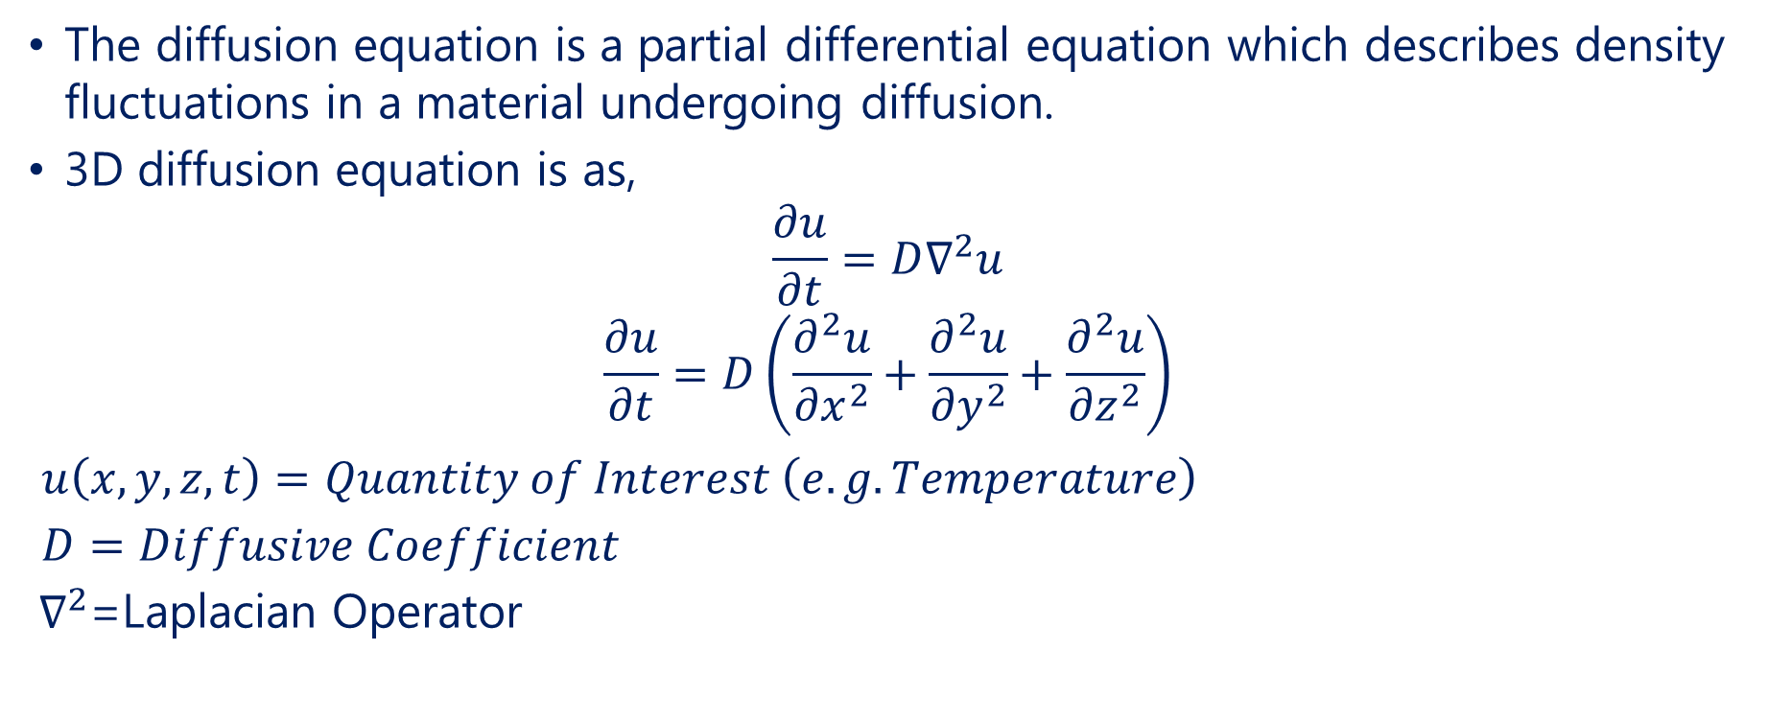
Diffusion Equation
The diffusion equation is a partial differential equation which describes density fluctuations in a material undergoing diffusion.
3D diffusion equation is as,
$$\frac{∂u}{∂t}=D∇^{2}u$$
$$\frac{∂u}{∂t}=D\left(\frac{∂^{2}u}{{∂x}^{2}}+\frac{∂^{2}u}{{∂y}^{2}}+\frac{∂^{2}u}{{∂z}^{2}}\right)$$
$u\left(x,y,z,t\right)=Quantity of Interest \left(e.g. Temperature\right)$
$D=Diffusive Coefficient$
${ ∇}^{2}$=Laplacian Operator

Slide 3
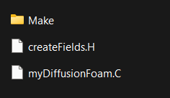
Code Development in OpenFOAM
OpenFOAM (Open Field Operation and Manipulation) is an open-source CFD toolkit designed for a wide range of applications, including fluid dynamics, heat transfer, and chemical reactions.
It provides a comprehensive suite of solvers, utilities, and libraries, enabling users to model complex physical processes.
OpenFOAM's architecture is modular and object-oriented, facilitating the development of custom solvers and utilities.
This design allows users to extend existing functionalities or create new ones by leveraging a vast library of pre-defined classes and functions.
The implementation of solvers and utilities typically involves writing C++ source files (.C) and header files (.H). These files define the core functionality and interface of the components being developed.

Slide 4
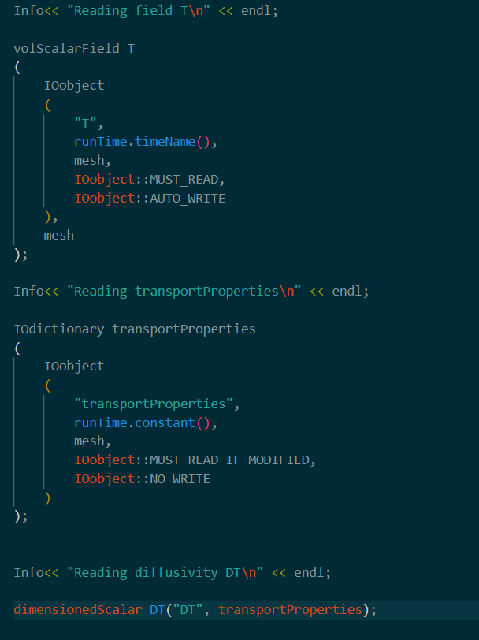
Header File
The temperature field is read using the volScalarField class.
They contain declarations of classes, functions, templates, and variables, making these components accessible to other parts of the code.
Header files define the public interface of classes, including member functions and data members, allowing other code to interact with these classes.
These prevent multiple inclusions of the same header file, which could lead to compilation errors.
IOobject reads field T, with MUST_READ ensuring it's required and AUTO_WRITE saving the data automatically.
transportProperties reads parameters like diffusivity, with MUST_READ_IF_MODIFIED only reading changes and NO_WRITE preventing automatic saving.
The transport properties dictionary is loaded from the case directory.

Slide 5
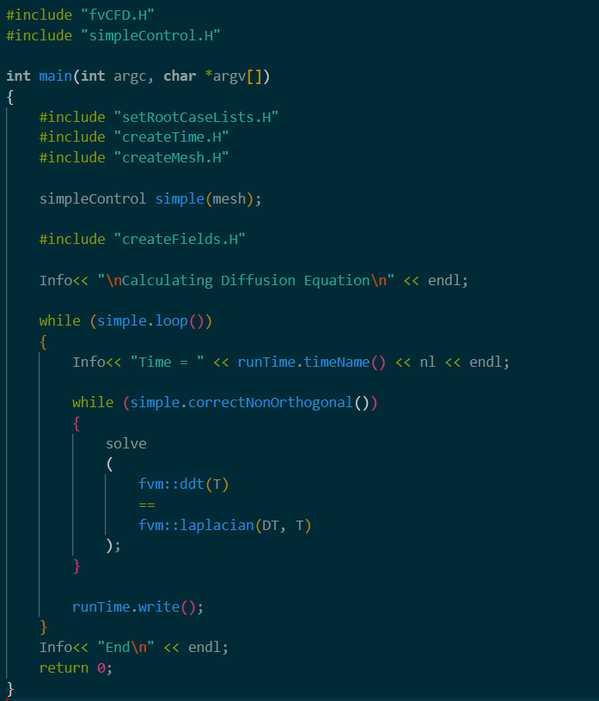
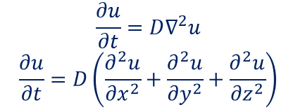
Source File
Source file includes its corresponding header and other necessary headers, such as fvCFD.H and fvm.H, which provide functions for discretization and solving.
The constructor initializes the field and coefficient. The destructor is defined but may be empty if no specific cleanup is required.
This file implements the core logic for solving the diffusion equation. It constructs a finite volume matrix equation representing the discretized form of the PDE and calls equation.solve() to compute the solution.

Slide 6
Source Code Explanation
fvCFD.H includes finite volume methods, while simpleControl.H manages simple time-stepping loops.
setRootCaseLists.H sets up case directories, createTime.H initializes simulation time, and createMesh.H generates the computational mesh.
Creates and initializes field variables, such as temperature (T) and diffusivity (DT), used in the simulation.
simpleControl manages time-stepping and convergence checks, linking to the mesh for simulation progression.
simple.loop() runs the simulation for each time step, while solve() computes the diffusion equation using fvm::ddt(T) for the time derivative and fvm::laplacian(DT, T) for the diffusion model.
Saves simulation results at each time step and indicates the completion of the simulation.

Slide 7
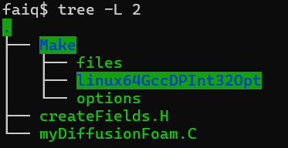
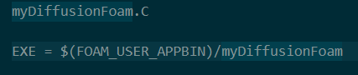
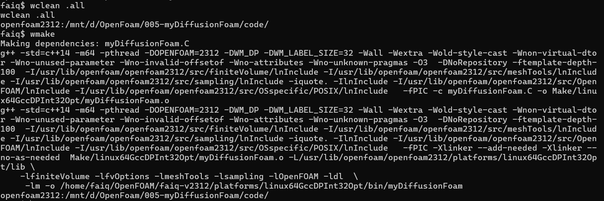
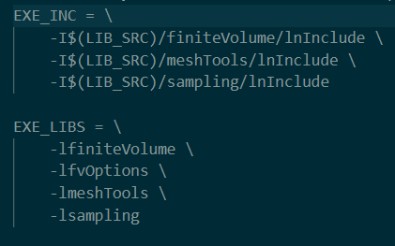
Integration and Compilation
OpenFOAM uses a wmake build system to compile C++ files. The Make directory typically contains files and options files that specify the source files to compile and the libraries to link against.
Compiling make directory to make sure solver works without any error.
Files
Options

Slide 8
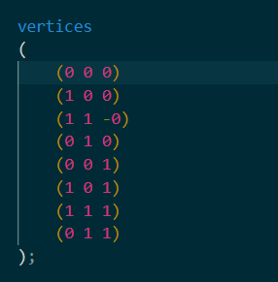
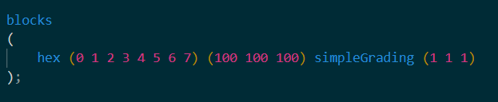
Mesh Configuration with blockMeshDict
Vertices:
Defines the coordinates of all vertices in the mesh.
Each vertex is specified as a vector of three components (x, y, z).
Blocks:
Defines the hexahedral blocks that make up the mesh.
Each block is defined by listing the vertices in a specific order, followed by the number of cells in each direction (x, y, z).
The grading parameter specifies how the cells are distributed within the block.

Slide 9
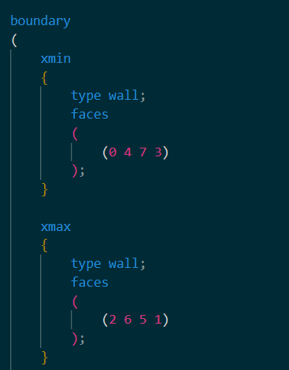
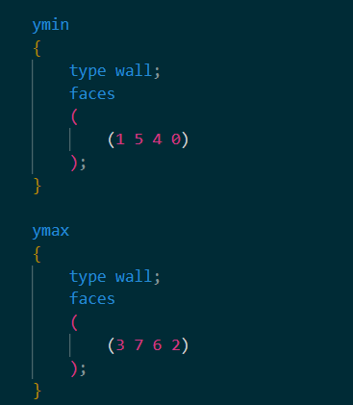
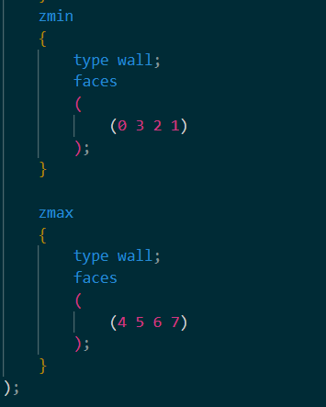
Mesh Configuration with blockMeshDict
Boundary:
Defines the boundary patches of the mesh, which correspond to the physical boundaries of the simulation.
Each boundary is given a name, type, and lists of the faces that belong to it.

Slide 10
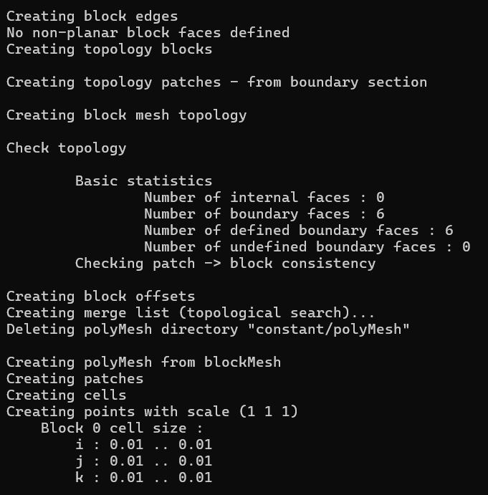
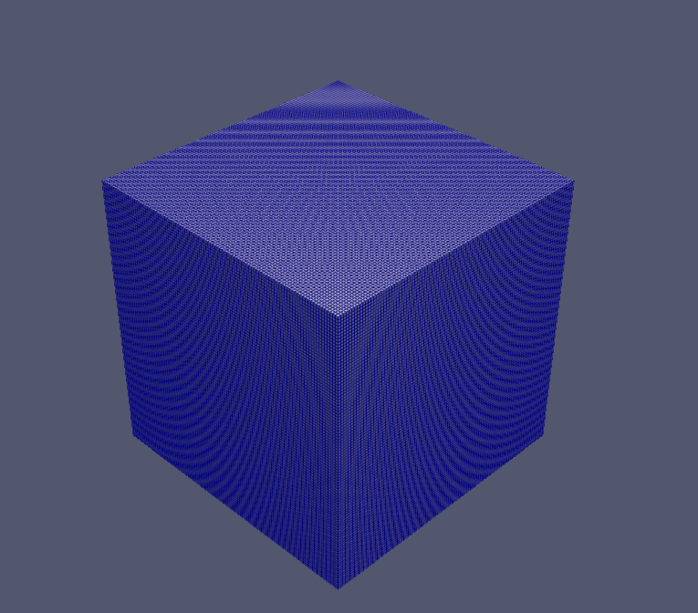
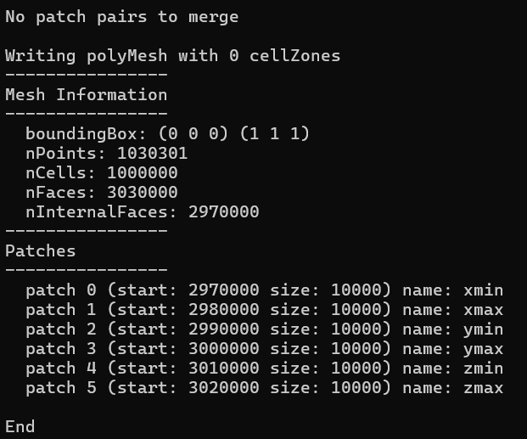
Creating Mesh
blockMesh

Slide 11
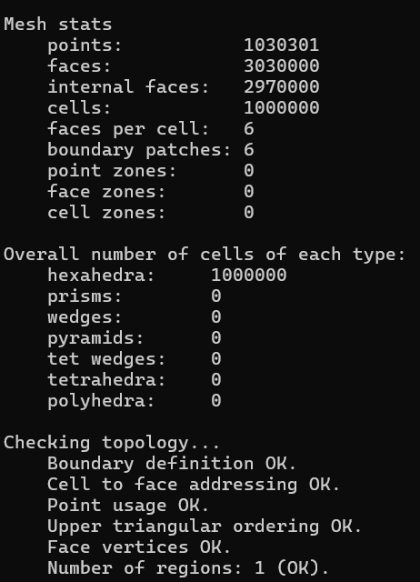
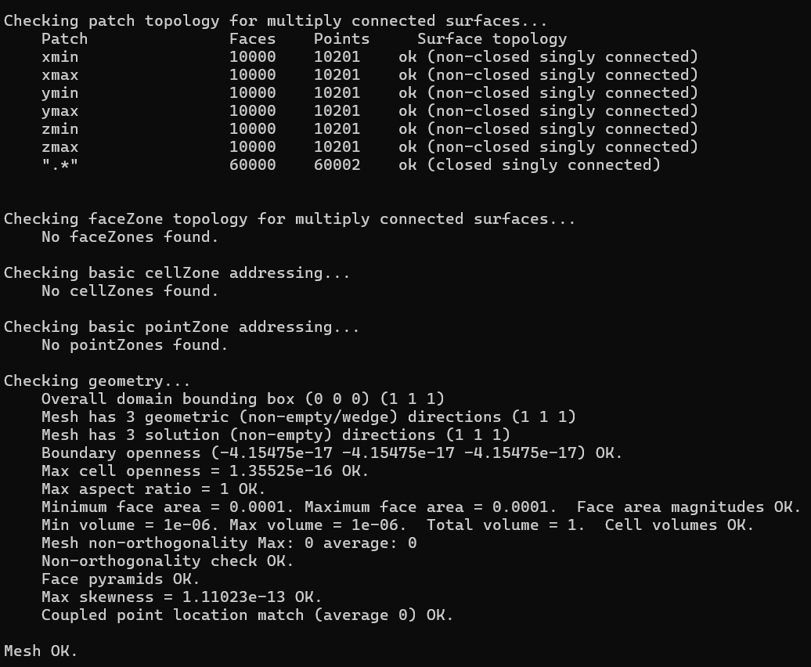
Running Simulation
The boundary definition is correct, and checks for cell-to-face addressing, point usage, and face vertices all passed without issues. The mesh contains 1 continuous region with no disconnected parts.
Ideal for structured grids
checkMesh
The mesh spans a bounding box from (0 0 0) to (1 1 1) with a maximum aspect ratio of 1, indicating no distortion. Face areas and cell volumes are uniform, with values of 0.0001 and 1e-06
The non-orthogonality is ideal with values of 0, skewness is very low at 1.11e-13, boundary openness is near zero which are required for perfect mesh.

Slide 12
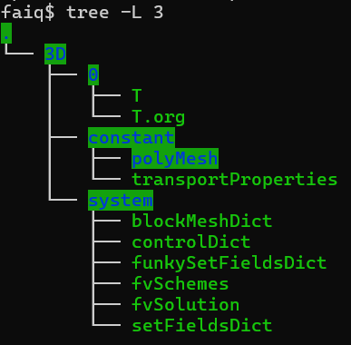
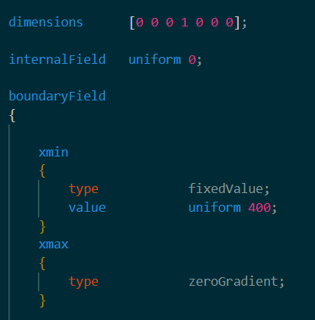
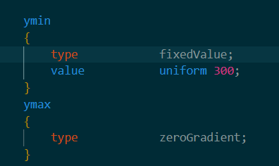
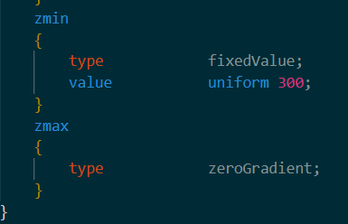
Test Case Setup
Setting up a simulation involves organizing and configuring files across several directories: system, constant, and 0. Each directory serves a specific purpose in defining the simulation environment, physical properties, and initial conditions
0 Directory:
The 0 directory is the initial time directory, where initial conditions for the simulation are specified.
Include boundary conditions and internal field values

Slide 13
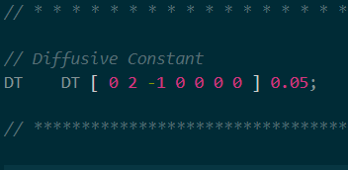
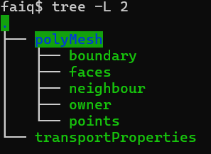
Constant Directory
The constant directory holds files that describe the physical properties of the simulation and the mesh configuration.
Transport Properties:
Defines physical properties such as the diffusion coefficient.
Critical for specifying how materials behave during the simulation.
PolyMesh
Contains mesh files like blockMeshDict used to define the geometry and mesh structure.
Specifies the mesh type, resolution, and boundaries.

Slide 14
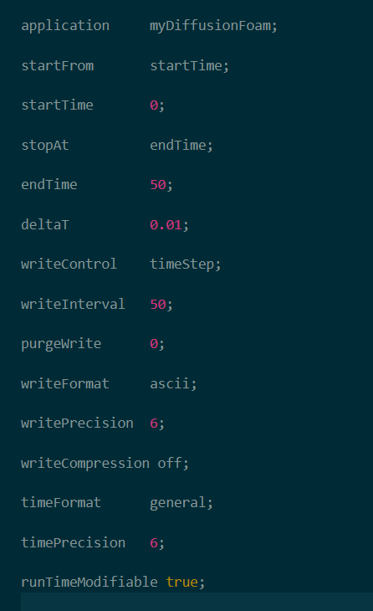
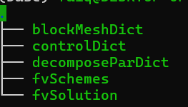
System Directory
The system directory contains files that control the overall simulation setup, including time-stepping, numerical schemes, and solver settings.
Control Dict:
Manages the simulation's start and end times, time step size, and data output frequency.

Slide 15
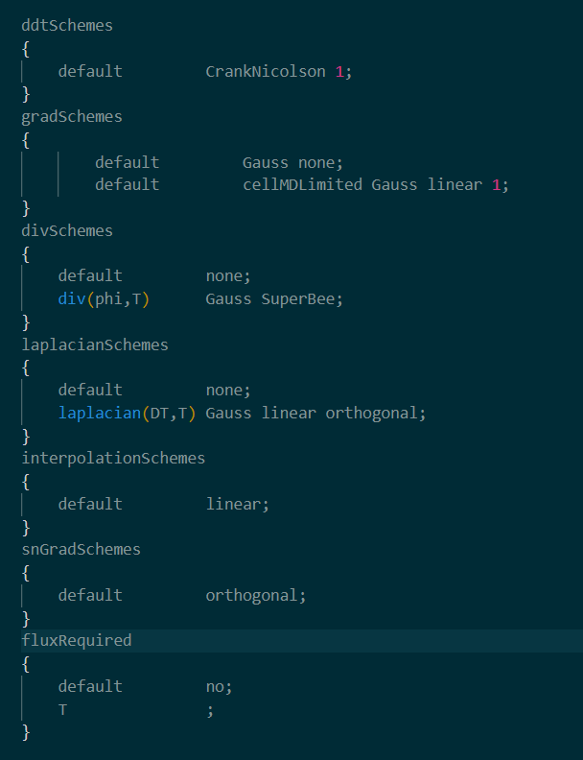
FvSchemes
Specifies the numerical schemes for discretizing differential equations.
Controls the accuracy and stability of the solution.
ddtSchemes
CrankNicolson 1: A time discretization scheme that blends implicit and explicit methods (Crank-Nicolson) with a weighting factor of 1 (fully implicit). It provides second-order accuracy in time and stability for transient simulations.
gradSchemes
Gauss none: No gradient scheme specified, but a more detailed gradient scheme is defined below.
cellMDLimited Gauss linear 1: A second-order gradient scheme using cell-based limited differencing (to prevent oscillations), suitable for capturing smooth gradients while avoiding unphysical results near discontinuities.

Slide 16
FvSchemes
divSchemes
div(phi,T) Gauss SuperBee: The SuperBee limiter is a high-resolution scheme for flux calculation. It reduces numerical diffusion while maintaining stability in capturing sharp gradients.
laplacianSchemes
laplacian(DT,T) Gauss linear orthogonal: This uses the Gauss theorem to compute laplacians with linear interpolation, assuming orthogonal mesh cells. It provides accurate diffusion terms in problems where the mesh is mostly aligned with the physical domain.
interpolationSchemes
linear: A basic second-order linear interpolation scheme, suitable for cases where smooth variations between cell values are expected.
snGradSchemes
Orthogonal: The orthogonal gradient scheme assumes that cell faces are perfectly perpendicular to the direction of gradient calculation, which simplifies and improves gradient accuracy when the mesh is orthogonal.

Slide 17
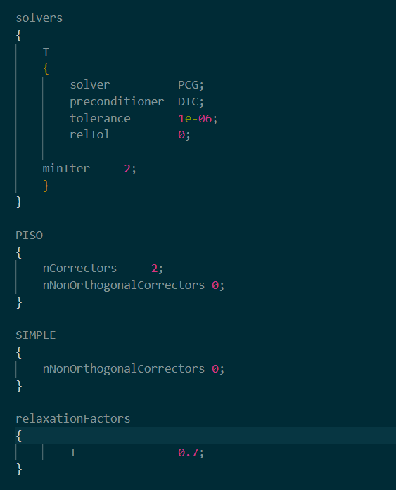
FvSolution
Contains solver settings and tolerance criteria for iterative solvers.
Defines how equations are solved during the simulation.
solvers: Uses PCG (Preconditioned Conjugate Gradient) for solving the temperature field with DIC (Diagonal Incomplete Cholesky) as a preconditioner for improved convergence.
PISOnCorrectors: Performs 2 corrector steps to enhance accuracy in transient simulations with no additional corrections for non-orthogonal meshes
SIMPLEnNonOrthogonalCorrectors: No non-orthogonal corrections applied, simplifying the solver approach.
relaxationFactors: Sets a relaxation factor for temperature to stabilize iterations and enhance convergence.

Slide 18
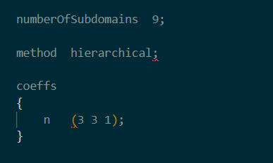
decompasePar
numberOfSubdomains: Specifies that the computational domain will be divided into 9 subdomains, allowing for parallel processing to improve computational efficiency and reduce simulation time.
method hierarchical: Indicates the use of a hierarchical method for domain decomposition. This method organizes subdomains in a hierarchical structure, optimizing the load balance and communication between processors.
coeffsn (3 3 1): Defines the decomposition coefficients. In this case, the domain is split into 3 subdomains in the x-direction, 3 in the y-direction, and 1 in the z-direction, effectively partitioning the computational space for parallel execution.

Slide 19
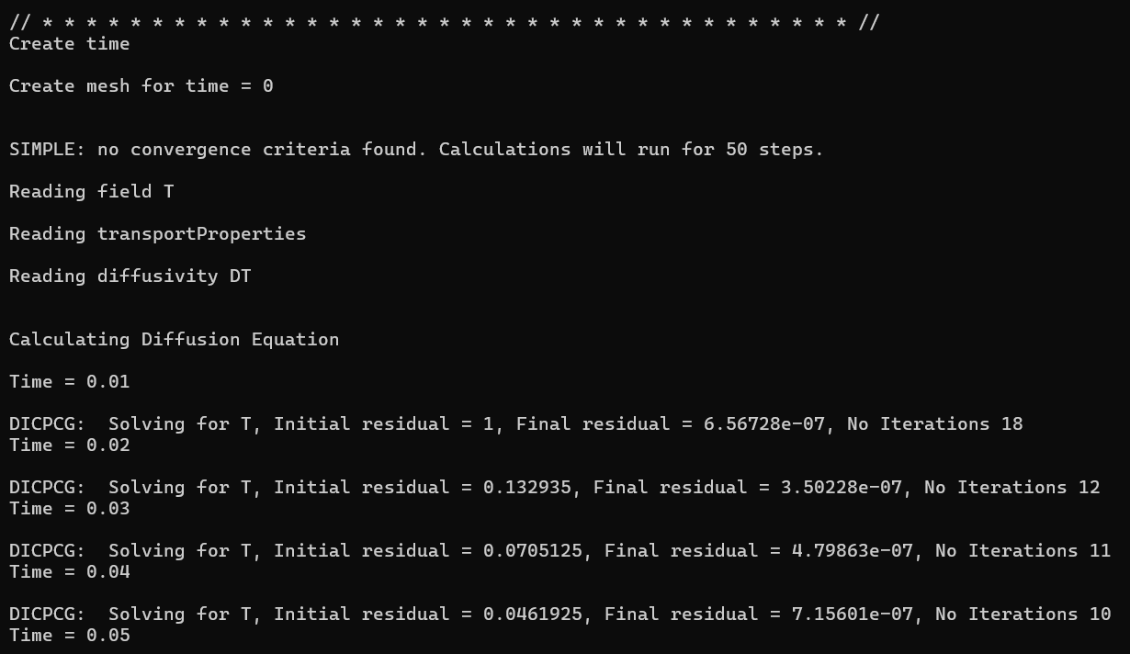
Running Simulation
myDiffusionFoam

Slide 20
Paraview
ParaView is an open-source, multi-platform data analysis and visualization application.
It is particularly well-suited for visualizing large datasets generated by simulations like those in OpenFOAM.
It uses visualization tools like Slice, Contour, Glyph, and Streamlines for exploring the results better. Further, we can also adjust visualization settings like Color Maps, Opacity, and Filters for detailed analysis.
How to open a case in Paraview? We can simply do that by following below commands.
Navigate to your case directory
cd <path-to-your-case-directory>
Create the .foam file (Makes a dummy file)
touch case.foam
Launch ParaView
paraview
In ParaView, go to File > Open, select case.foam, and click OK. Then, click Apply to load the data.

Slide 21
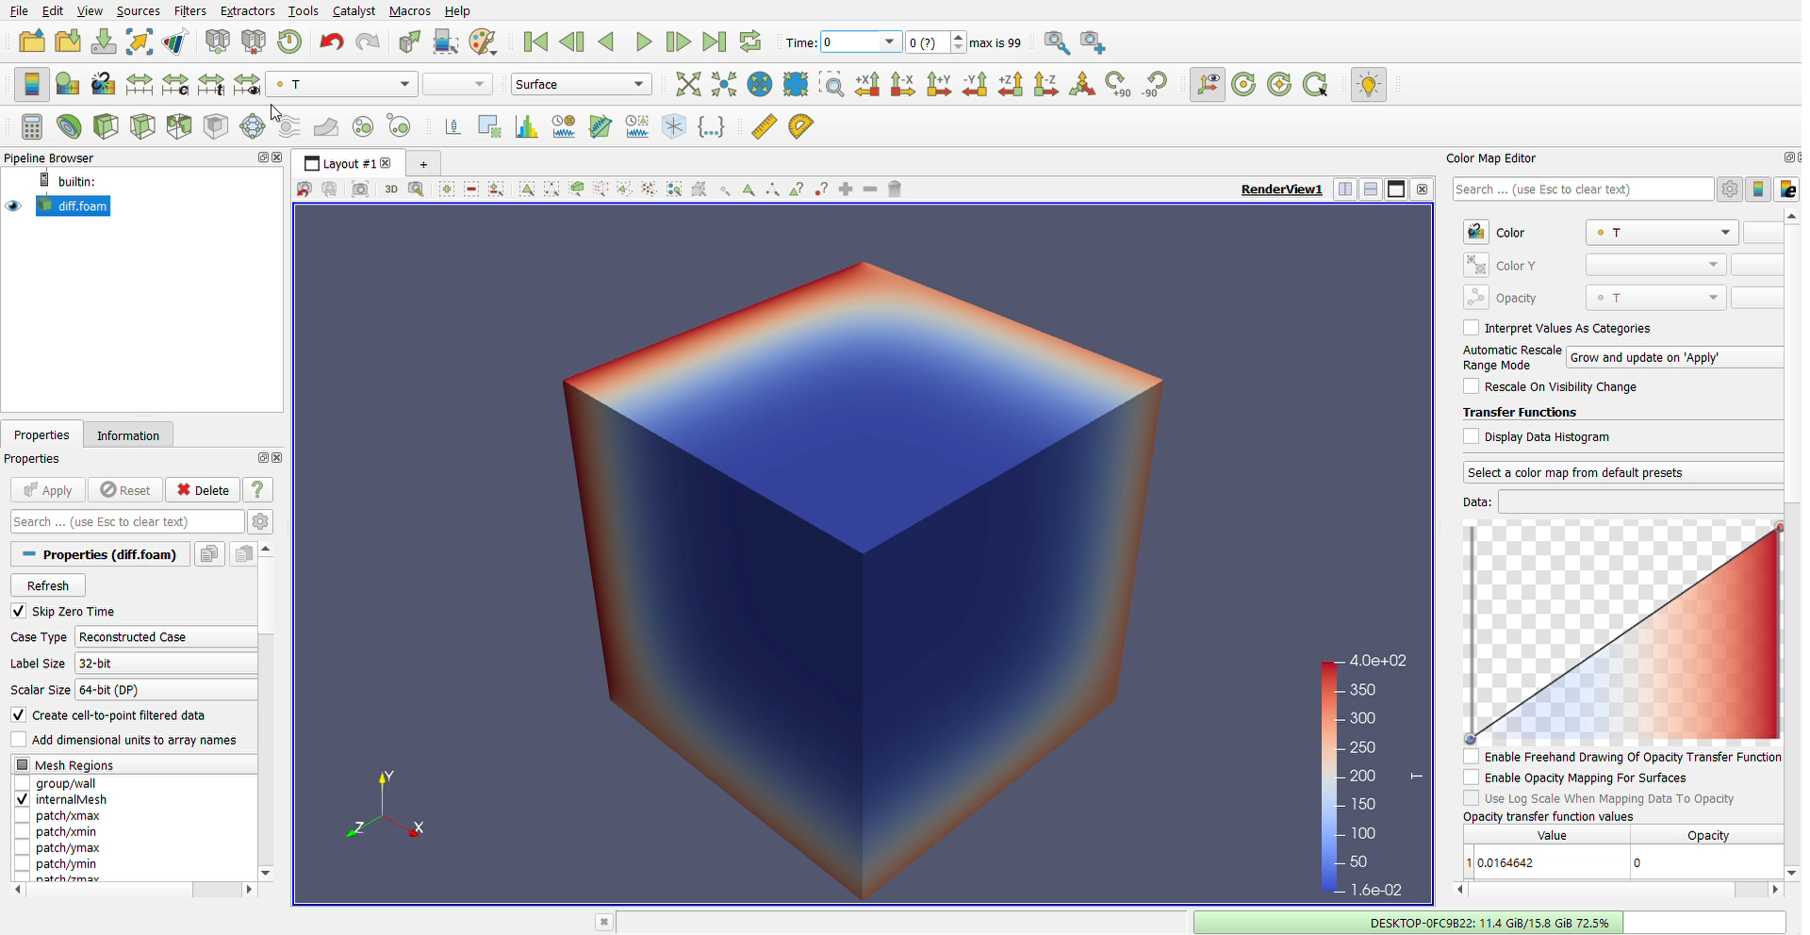
Results
Results in Paraview

Slide 22
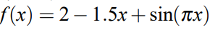
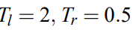
Running Simulation – Example 2
Performing another example using different initial and boundary conditions.
Initial Heat Distribution was taken as,
Boundary conditions were taken as,
Where l = min , r = max for each axis.
Initial condition and Boundary conditions were set using swak4Foam.
Swak4Foam:
swak4Foam integrates with OpenFOAM's function object framework, allowing users to perform complex data processing and output.
Function objects can be used for real-time data monitoring, custom post-processing, and field manipulation during the simulation.

Slide 23
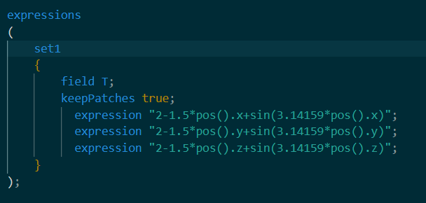
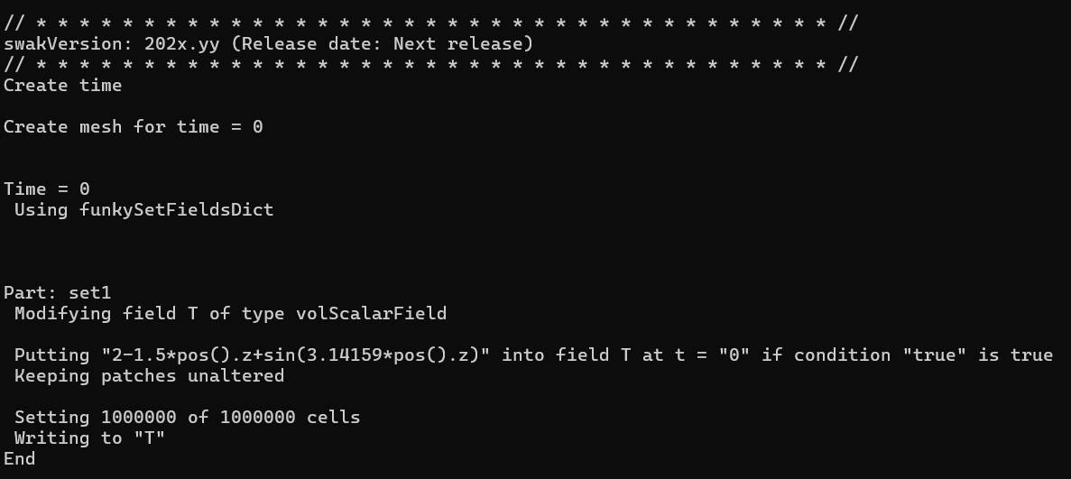
Boundary Conditions– Example 2
funkySetFieldsDict
funkySetFields –time 0

Slide 24
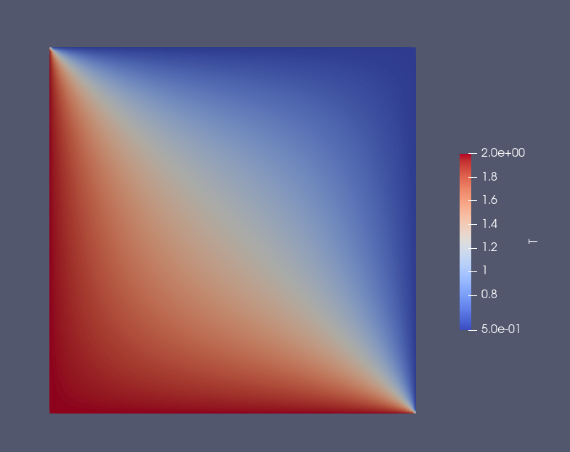
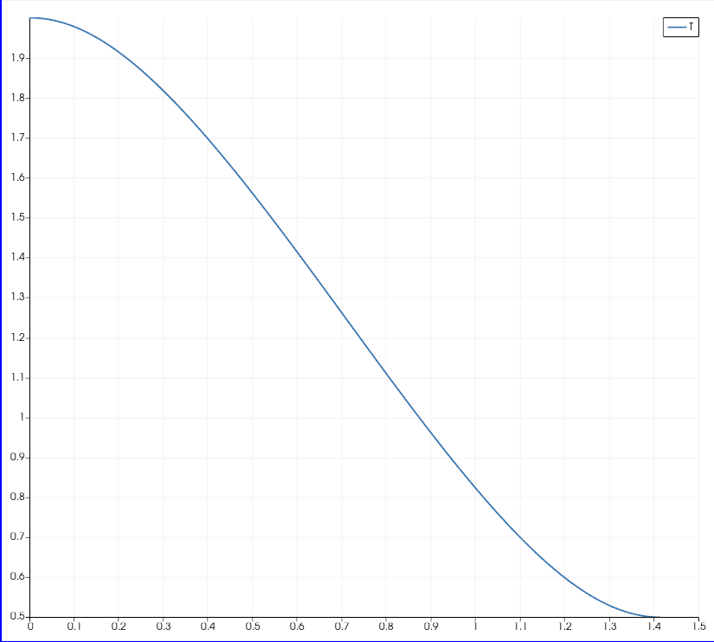
Results– Example 2

Slide 25
References
https://www.openfoam.com/documentation/user-guide
https://www.openfoam.com/documentation/overview
https://openfoam.org/search/programming+guide/

